Slide 1
🌟 Failure: Not the End

Slide 2
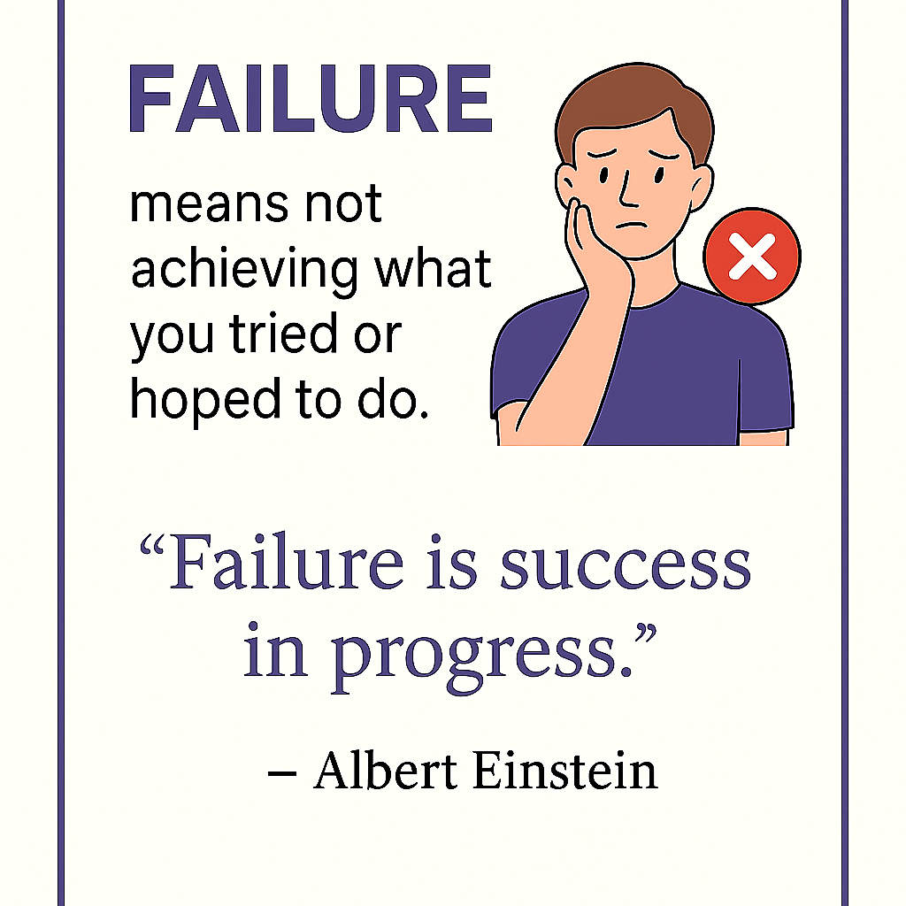
What is Failure ?

Slide 3
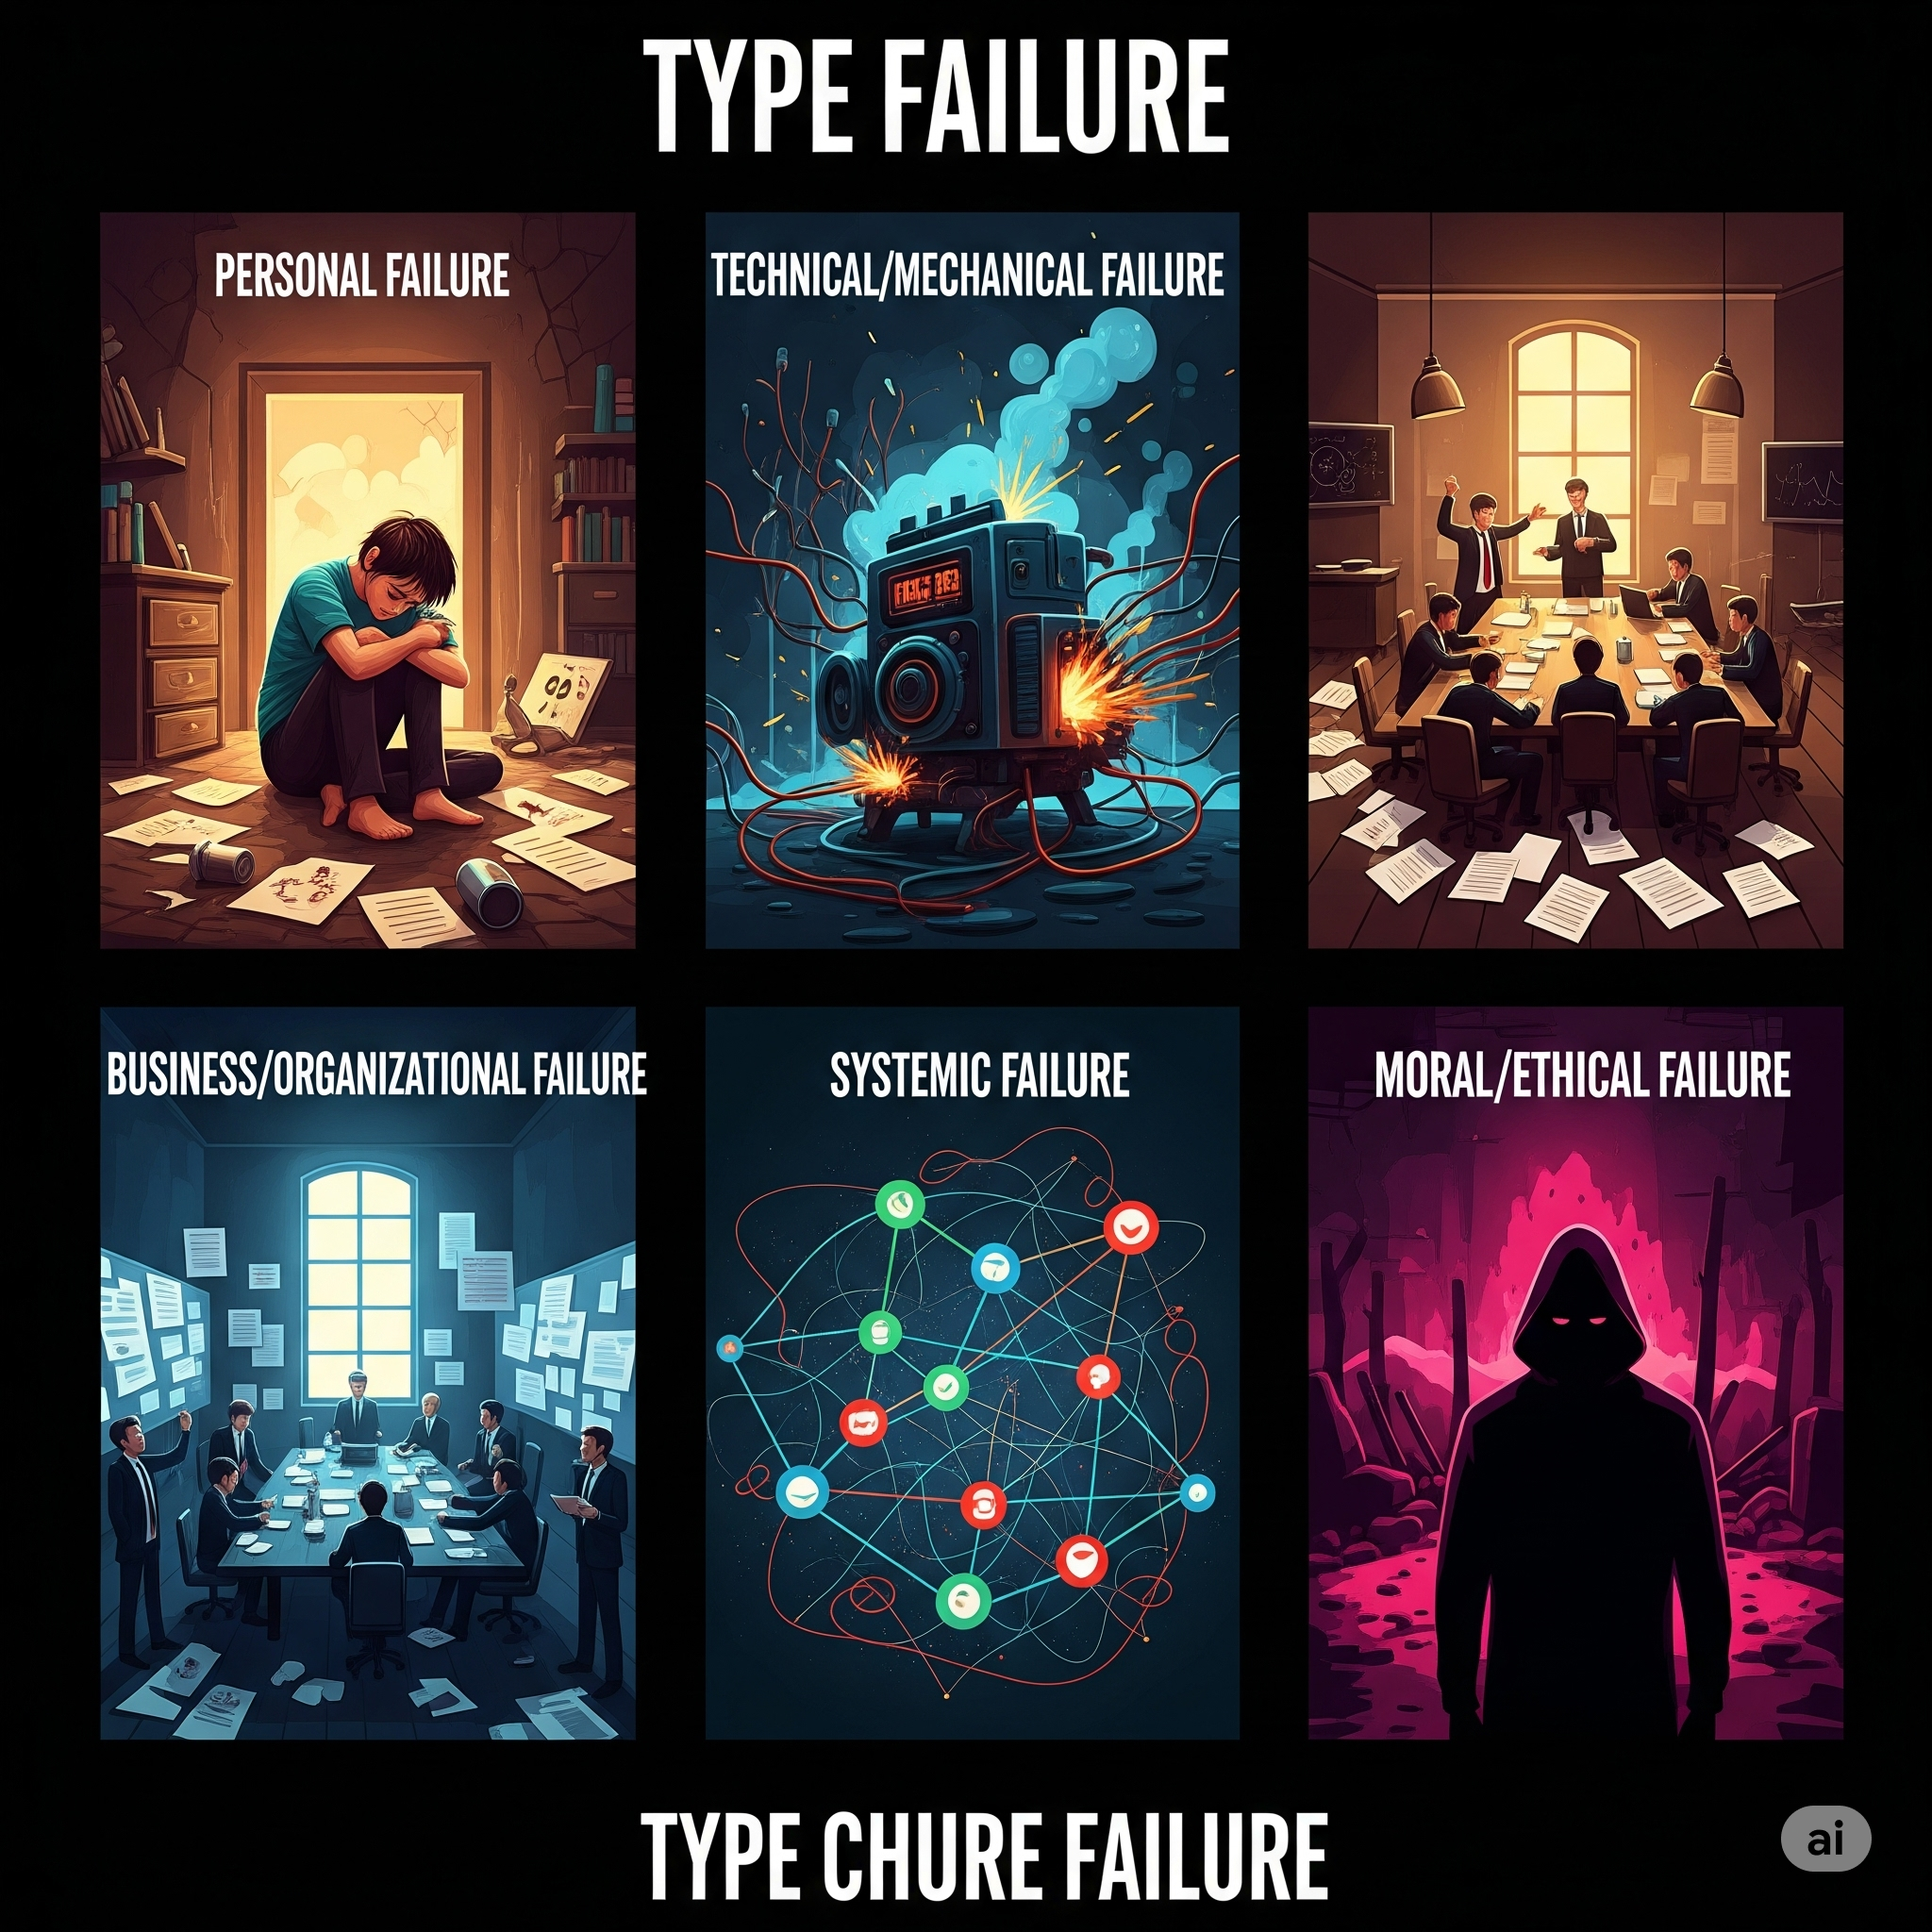

Slide 4
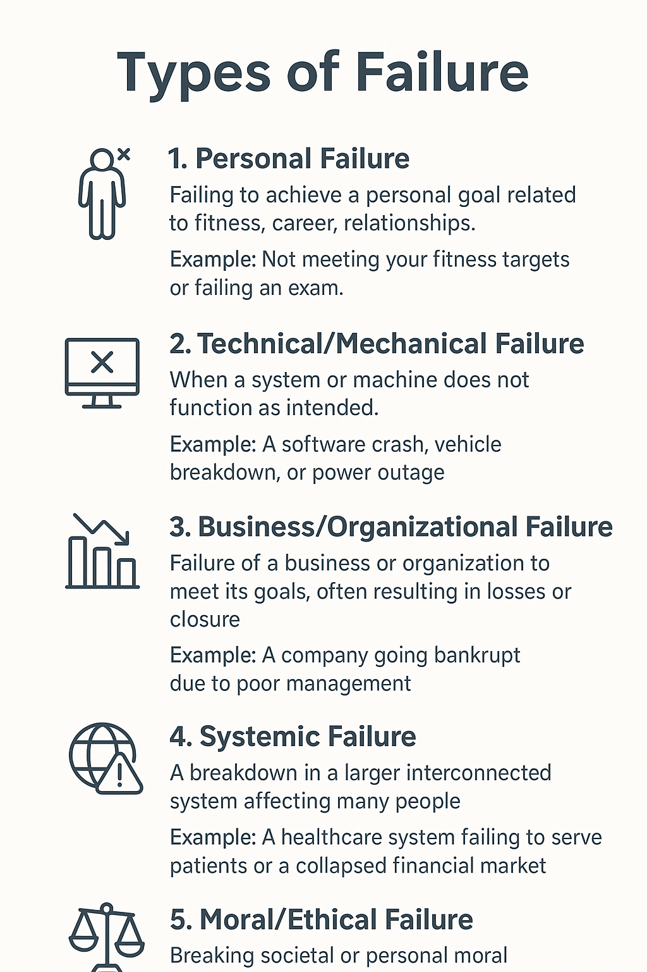

Slide 5
Why Failure is importance?
✅ Failure is not the opposite of success — it is a part of success.
🌱 Every failure brings you closer to your goal.
💪 Keep learning, keep trying, and never stop growing.

Slide 6
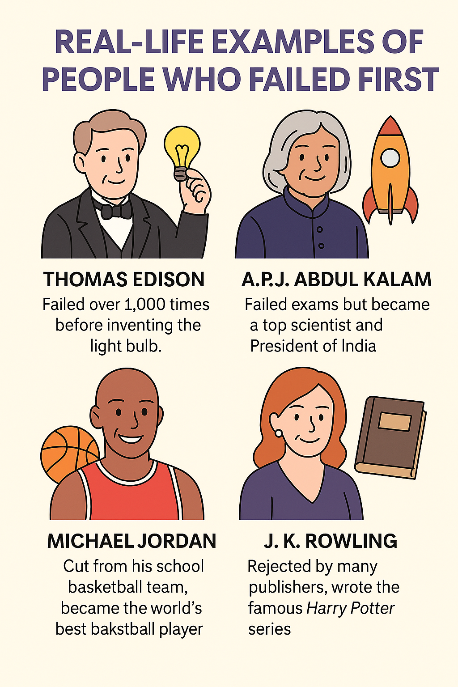
Real-Life Inspiration

Slide 7
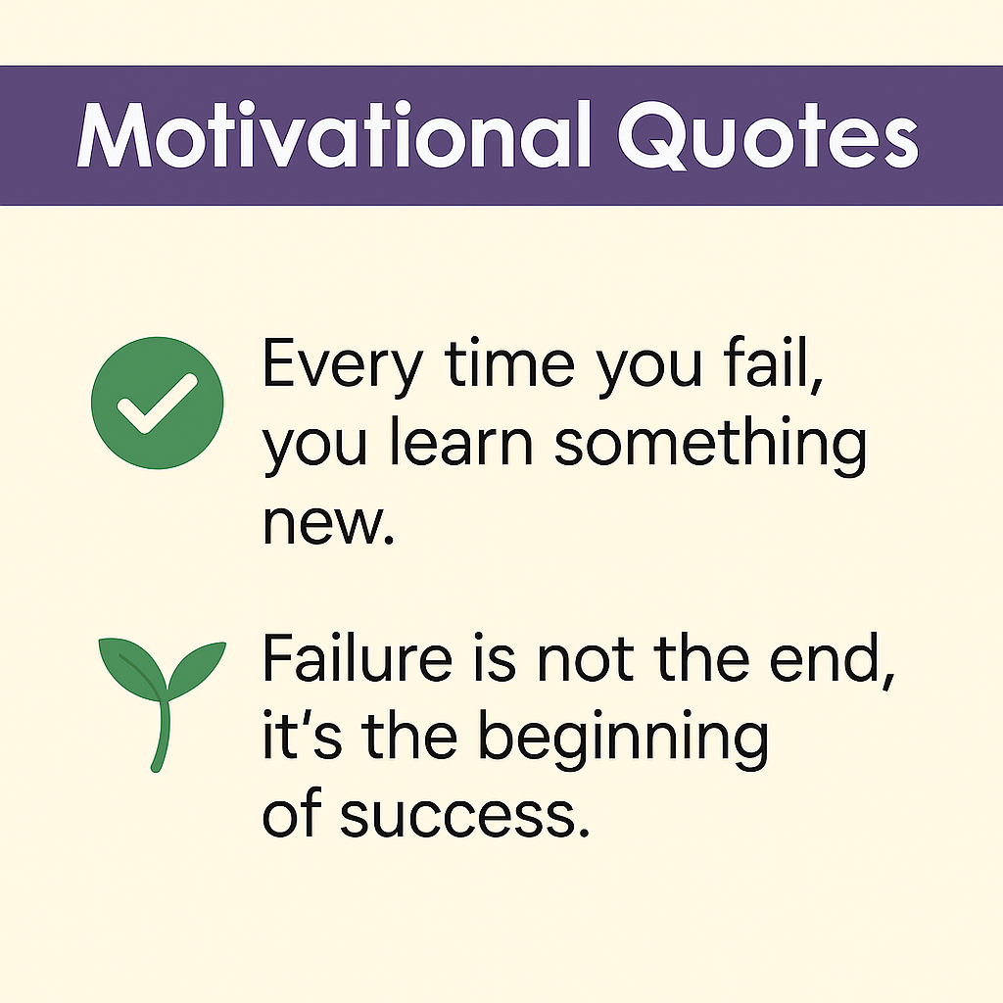
Motivational Quotes

Slide 8
Thank You!
"So, friends, Next time you fail, Don’t give up. Learn from it, grow from it, and come back stronger! "

